Slide 1
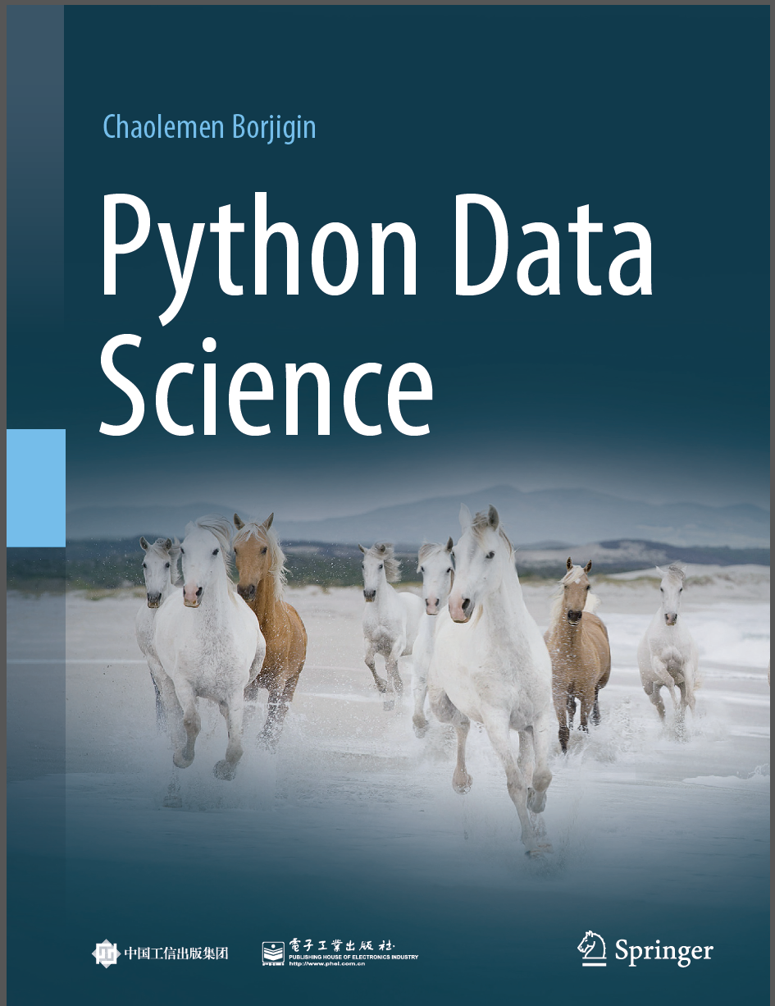
Python Data Science
Chaolemen Borjigin
Renmin University of China
chaolemen@ruc.edu.cn

Slide 2
2.20 Lambda functions
▼ Chapter 2 Basic Python Programming for Data Science
► 2.20 Lambda functions
Chaolemen Borjigin
Renmin University of China
chaolemen@ruc.edu.cn

Slide 3
Summary of this chapter
▼ Chapter 2 Basic Python Programming for Data Science
► 2.20 Lambda functions
2.20.1 Defining a lambda function
2.20.2 Calling a lambda function

Slide 4
2.20.1 Defining a lambda function
▼Chapter 2 Basic Python Programming for Data Science
► 2.20 Lambda functions
In[1]:
x=2
y= lambda x:x+3
y(2)
Out[1]:
5
In[2]:
x=2
def myfunc(x):
return x+3
myfunc(2)
Out[2]:
5

Slide 5
2.20.2 Calling a lambda function
▼Chapter 2 Basic Python Programming for Data Science
► 2.20 Lambda functions
In[3]:
MyList = [1,2,3,4,5,6,7,8,9,10]
filter(lambda x: x % 3 == 0, MyList)
Out[3]:
<filter at 0xb656ac27f0>
In[4]:
list(filter(lambda x: x % 3 == 0, MyList))
Out[4]:
[3, 6, 9]

Slide 6
2.20.2 Calling a lambda function
▼Chapter 2 Basic Python Programming for Data Science
► 2.20 Lambda functions
In[5]:
list(map(lambda x: x * 2, MyList)))
Out[5]:
[2, 4, 6, 8, 10, 12, 14, 16, 18, 20]
In[6]:
from functools import reduce
reduce(lambda x, y: x + y, MyList)
Out[6]:
55

Slide 7


